Slide 1
Smart HVAC Energy Optimization & AI-Powered Predictive Maintenance System
An Intelligent Facility Management Platform
Team Members:
A fully implemented AI-powered platform delivering intelligent energy optimization, predictive maintenance, and real-time analytics for modern facility management.
Shristi Sharma
Satvik Pandey
Shashank M M
Snehith Reddy Anuka
Sahil Manoj Shah
Sai Charan
Project Mentor: Sangeetha Mahalingam

Slide 2
Problem Statement & Implemented Solution
BEFORE
AFTER
Traditional HVAC Challenges
AI-Powered Smart HVAC System
High Energy Costs
Automated Data Processing
ML Predictive Insights
Uncontrolled consumption and inflated operational expenditures across facilities
Machine learning models deliver proactive fault detection and maintenance alerts
End-to-end pipeline handles ingestion, cleaning, and real-time analysis
Reactive Maintenance
Unexpected equipment failures with no predictive warning systems in place
Intelligent Optimization
Energy efficiency recommendations and executive KPI dashboards delivered continuously
Manual Monitoring
Limited visibility into system performance with no centralized analytics

Slide 3

Implemented System Architecture
Data Tier
ML Tier
Presentation
The architecture operates across three integrated tiers — raw data ingestion, machine learning processing, and interactive presentation — enabling seamless real-time analytics delivery.
Data Processing
Machine Learning
Automated loading, cleaning, and timestamp normalization across all facility datasets
Feature engineering and predictive model training powering fault detection and energy insights
Backend API
Dashboard Analytics
Flask-based REST API serving real-time analytics to the frontend dashboard
React-based interactive visualization delivering live monitoring and operational reporting

Slide 4
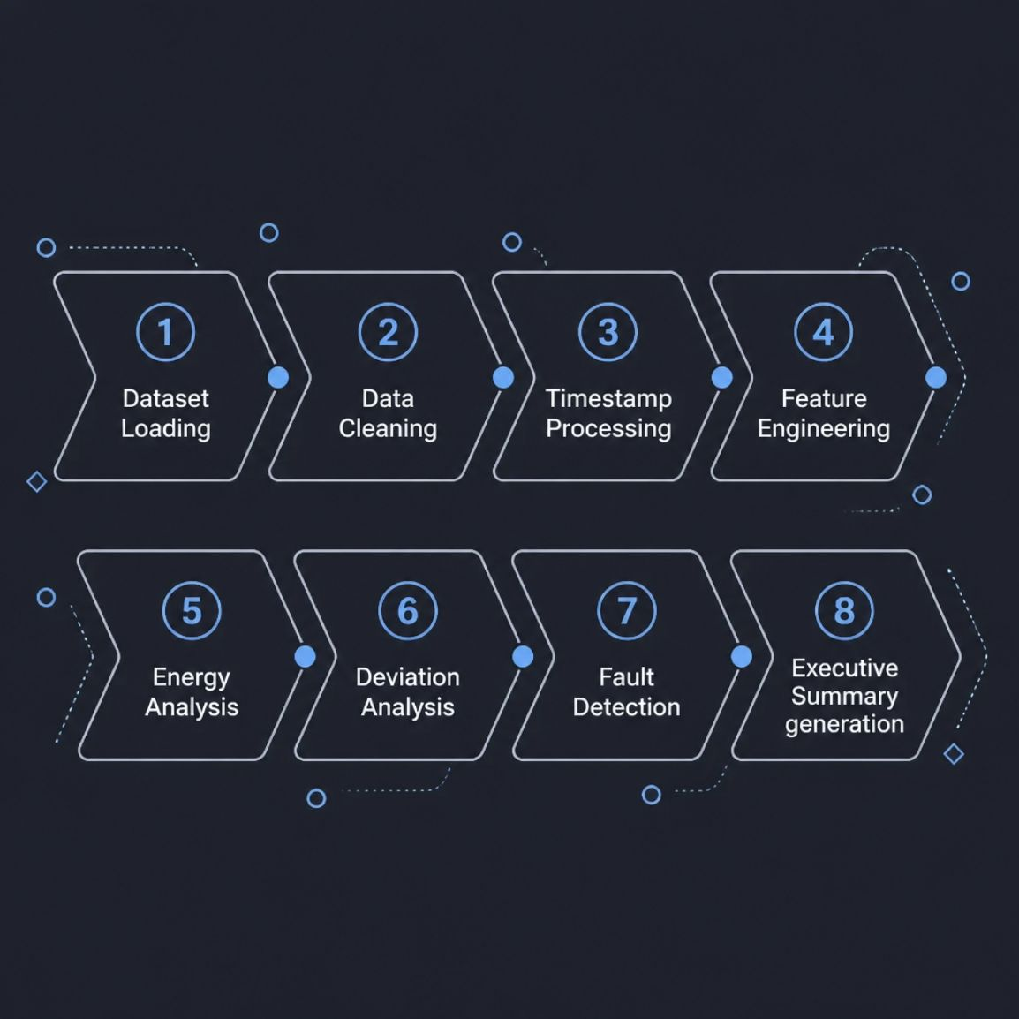
Data Processing & Machine Learning Pipeline
Processing Capabilities
1
Feature Engineering
Rolling statistics and temporal feature extraction from sensor data, including temperature, pressure, and humidity readings
2
Energy Analysis
Consumption pattern analysis and efficiency metrics across facility zones
3
Fault Detection
Random Forest model achieving 100% accuracy on fault classification for Condenser Fouling, Evaporator Fouling, and Refrigerant Overcharge/Undercharge
4
Executive Summary
Automated KPI generation and risk classification (High/Medium/Low) with actionable maintenance alerts

Slide 5
Dashboard & Analytics Platform
The system displays real-time monitoring, energy consumption analysis, building health metrics, fault detection, and executive summaries through an integrated analytics dashboard.
Energy Consumption
Building Summary
Real-time and historical energy usage tracking with trend analysis
Facility-wide operational status and performance metrics at a glance
Site Deviation
Building Health
Performance variance analysis and threshold-based alerting system
System integrity and component status monitoring across all HVAC units
Fault Detection
Executive Summary
Automated anomaly detection and predictive failure identification in real time
High-level insights and actionable recommendations for facility leadership

Slide 6
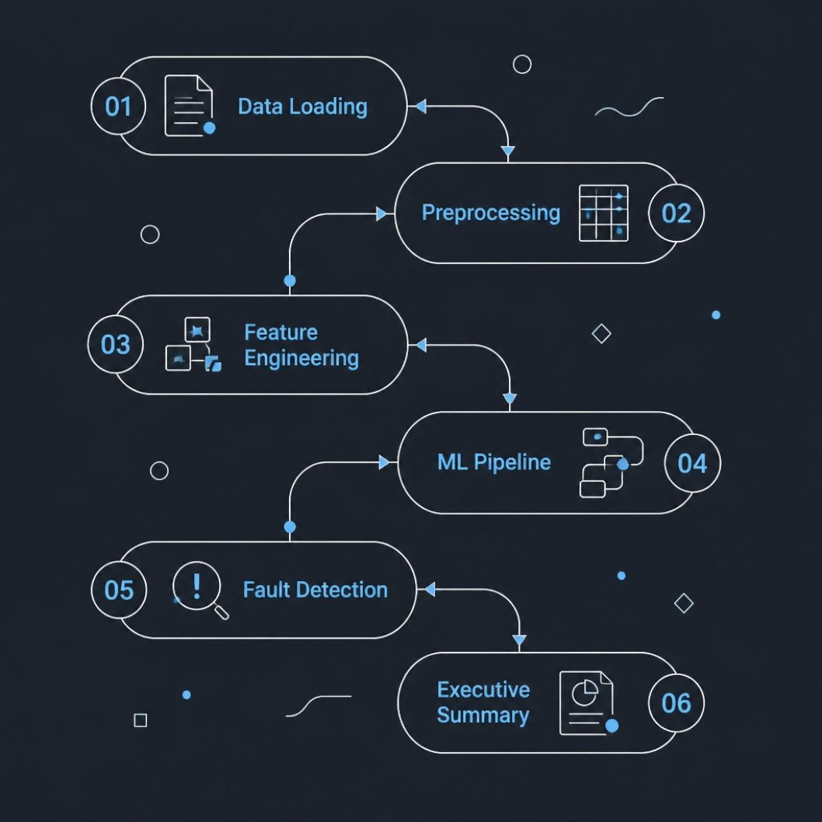

Technology Stack & Implementation
Frontend & Backend
Implemented Modules
1
2
Frontend
Backend
React with Plotly and Matplotlib for interactive visualizations
Flask REST API serving real-time predictions (<1ms per prediction)
Machine Learning & Data
1
2
ML Framework
Datasets
Python with Scikit-learn, Pandas, NumPy, and a Random Forest model
15 fault detection datasets covering 6 fault types: Condenser Fouling 10/20/30%, Evaporator Fouling 10/20/30%, Refrigerant Overcharge/Undercharge 10/15/20%, plus healthy baseline and real-world site data
Production-ready system with batch processing capability (50K systems in ~5 seconds) and real-time API deployment options

Slide 7




Project Outcomes & Key Achievements
System Capabilities Delivered
Intelligent HVAC Monitoring
AI-Driven Fault Detection
Real-time system performance tracking with 6 dashboard modules (Energy Consumption, Building Summary, Site Deviation, Building Health, Fault Detection, Executive Summary)
Random Forest model with 100% accuracy detecting 6 fault types; predictive maintenance alerts prevent equipment failures
Energy Optimization
Automated Reporting
Data-driven consumption analysis and efficiency recommendations; batch processing handles 50K systems in ~5 seconds
Executive KPI dashboards with risk classification (High/Medium/Low) and actionable maintenance recommendations
"Transforming Traditional HVAC Systems into Intelligent Smart Facility Management"

